Slide 1

All About Notes
DYNAMICS 365

Slide 2

Mitch Milam
Dynamics CRM Architect
mitch@xrmcoaches.com
@mitchmilam
http://tinyurl.com/MitchMilamLinkedIn

Slide 3
Future Events
Workshop: Dynamics CRM JavaScript Development
Introduction to Dynamics CRM JavaScript development including which tools to use, best practices, and code samples.
Tuesday, January 17th
Webinar: Dynamics 365 new feature overview
In this webinar we will cover some of the new features that have shipped with Dynamics 365.
Fri, Jan 20, 2017 10:00 AM - 11:00 AM CST

Slide 4
Future Events
Webinar: Using Microsoft Flow with Dynamics 365
In this webinar we will introduce you to using Microsoft Flow with Dynamics 365.
Fri, Jan 27, 2017 10:00 AM - 11:00 AM CST
Webinar: Dynamics 365: Business Rules Revisited
With the changes to the Business Rule Designer introduced in Dynamics 365, I thought it would be a good idea to revisit the creation and use of Business Rules for Dynamics 365.
Fri, Feb 3, 2017 10:00 AM - 11:00 AM CST

Slide 5
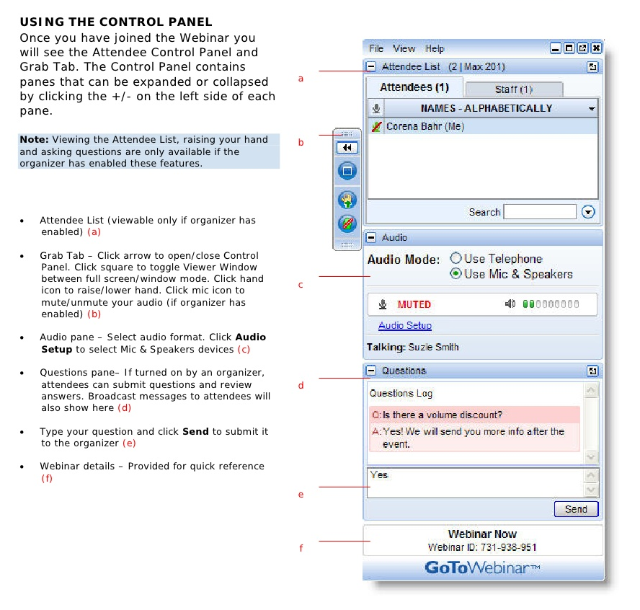
Webinar Housekeeping

Slide 6


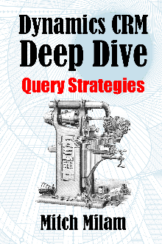
2017 Training Roadmap
Webinars
http://www.xrmcoaches.com/webinars
KnowledgeBits
http://www.xrmcoaches.com/knowledgebits
Learning Plans
http://www.xrmcoaches.com/freestuff
More Goodies
Practice tests
On–Demand video training
Instructor–led training
Books

Slide 7
Agenda
What is a note
Notes vs Everything else
Discussion

Slide 8
What is a Note?

Slide 9
Types of Notes
Note
Activity
Document (SharePoint or Attachment)
OneNote
Yammer
Office 365 Groups

Slide 10
Notes vs. Activities
Activities roll-up from Contacts to Accounts
Notes do not roll-up
Activities have categories, notes do not
You may add custom fields to activities, not notes
Searchability

Slide 11
Recording Conversations
Who?
When?
What?
Why?
Annotation, Thread, or Conversation?

Slide 12
Annotation (Note)
Tied to a specific record
May be text or an attached document
Documents are not editable
Annotation entity may not be customized
Notes are not editable in some earlier versions of Dynamics CRM

Slide 13
Activity
Category-specific
Customizable
Rolls-up to parent entity (Account) for certain related entities

Slide 14
Document
Stored as an Annotation or in SharePoint
SharePoint allows for modification, versioning, etc.

Slide 15
OneNote
More robust editing capability

Slide 16
Yammer
For conversations within a group or team
Saves all conversations so a history is available

Slide 17
Office 365 Groups
Combines many features of conversations and documents
Visible outside of Dynamics 365

Slide 18
Questions?

Slide 19
Thank You

